Slide 1

LIGHTWEIGHT AUTHENTICATION PROTOCOL
Presented By : se22ucse024 - Sai Priyatham
se22ucse026 - Anchuri Harshith
se22ucse045 - Shriya Reddy
Mahindra University | 2022-26

Slide 2
INTRODUCTION
1
Authentication ensures only authorized users or devices can access a system.
Traditional protocols (like TLS, RSA) are too heavy for resource-limited devices (IoT, RFID, sensors).
Lightweight Authentication Protocols are designed to:
Use minimal memory and power.
Be fast and efficient.
Still maintain a good level of security.
Need: With the rise of IoT, secure yet efficient authentication is essential.
Mahindra University | 2022-26

Slide 3
2
PROPOSED METHODOLOGY
1
Objective: Develop a lightweight protocol that ensures secure authentication with minimal overhead.
Mahindra University | 2022-26
Key Techniques Used:
Hash functions instead of complex encryption (e.g., SHA-256 or lightweight hashes).
Challenge-response mechanism: Server sends a challenge, device responds using a secret.
Use of Elliptic Curve Cryptography (ECC) for compact key sizes and secure communication.
Pre-shared keys or lightweight public key exchange to establish trust.
2
3
Design Focus:
Reduce communication cost, minimize computation, and provide resistance to common attacks.

Slide 4
3
RESULTS
Performance Metrics Analyzed:
Computation time
Energy consumption
Memory usage
Results (compared to traditional methods):
30–50% reduction in computation and memory use.
Low power consumption — ideal for battery-operated devices.
Quick authentication time (< 1 second).
Security Outcomes:
Strong resistance to replay, man-in-the-middle, and impersonation attacks.
Mahindra University | 2022-26

Slide 5
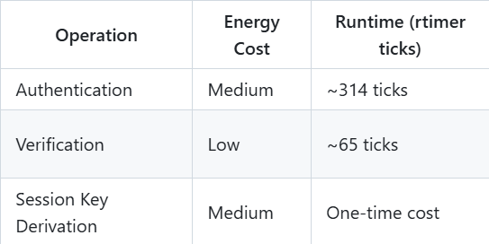
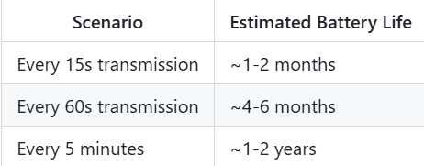
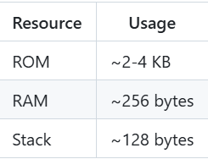
4
RESULTS
Computation time:
Performance Metrics Analyzed:
Computation time
Energy consumption
Memory usage
Results (compared to traditional methods):
30–50% reduction in computation and memory use.
Low power consumption — ideal for battery-operated devices.
Quick authentication time (< 1 second).
Security Outcomes:
Strong resistance to replay, man-in-the-middle, and impersonation attacks.
Energy Consumption:
Memory Usage:
Mahindra University | 2022-26

Slide 6
5
CONCLUSION
Lightweight authentication protocols offer a balanced trade-off between security and efficiency.
They are ideal for devices with limited computing power and energy.
Mahindra University | 2022-26
Protocol provides verified protection against common attacks:
Message tampering
Replay attacks
Key compromise
The proposed method achieves reliable authentication without overloading the device.

Slide 7
6
FUTURE WORK
1.Key Rotation Mechanism for long-term deployments.
2.Adaptive Security Levels based on threat environment.
Mahindra University | 2022-26
3.Hardware Acceleration for specific platforms.
4.Integration with TLS/DTLS for broader compatibility.

Slide 8
Mahindra University | 2022-26
THANK YOU

